Slide 1

SDG 15: Life on Land
Presented by Shashravat Ejjagiri

Slide 2

Agenda
Deforestation
Biodiversity Loss
  Forest degradation
  Climate impact
  Extinction crisis
  Habitat destruction

Slide 3
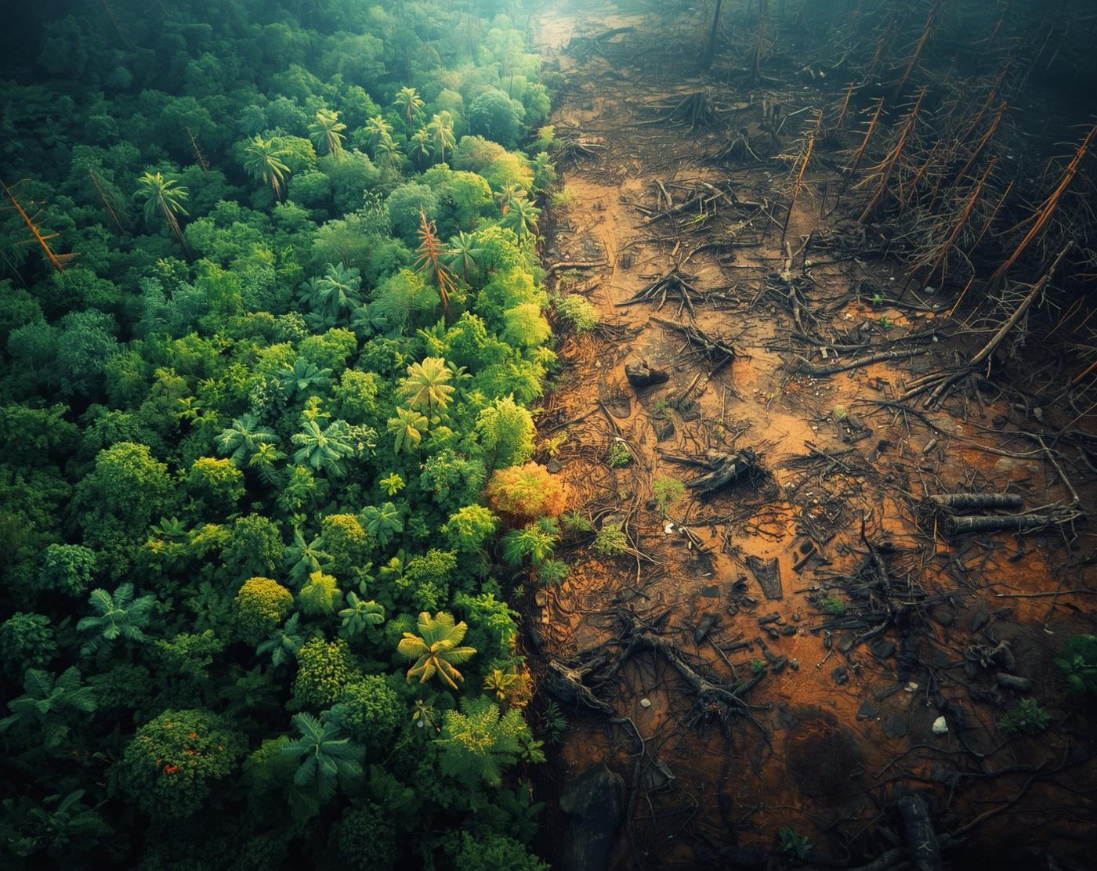
Deforestation: A Global Emergency
Understanding its impact on biodiversity and climate
Deforestation threatens ecosystems and displaces wildlife rapidly

Slide 4

Causes
Agriculture
Logging
Mining
Urbanization
Expanding crop production demands land
Unsustainable timber extraction harms ecosystems
Resource extraction disrupts habitats significantly
Expanding cities encroach on forests

Slide 5
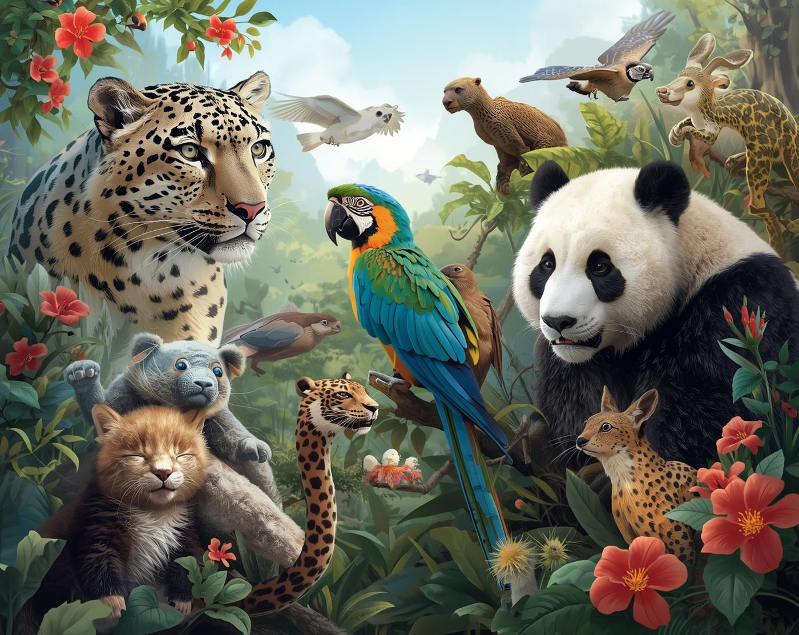
Biodiversity Loss and Its Consequences
Understanding the urgent crisis of extinction
Many species are disappearing every year

Slide 6
Drivers
Habitat
Climate
Pollution
Overexploitation
Loss of natural environments
Global temperature fluctuations rise
Contamination of ecosystems occurs
Unsustainable resource extraction impacts

Slide 7
Sustainable Land Management

Slide 8
Sustainable Strategies
Reforestation
Agriculture
Management
Ecotourism
Restoring forests to combat climate change
Practices that enhance soil health sustainably
Empowering communities for resource conservation
Promoting nature while supporting local economies

Slide 9
420 million
1 million
15%
Forest cover loss globally
Species at risk of extinction
Protected area coverage worldwide

Slide 10
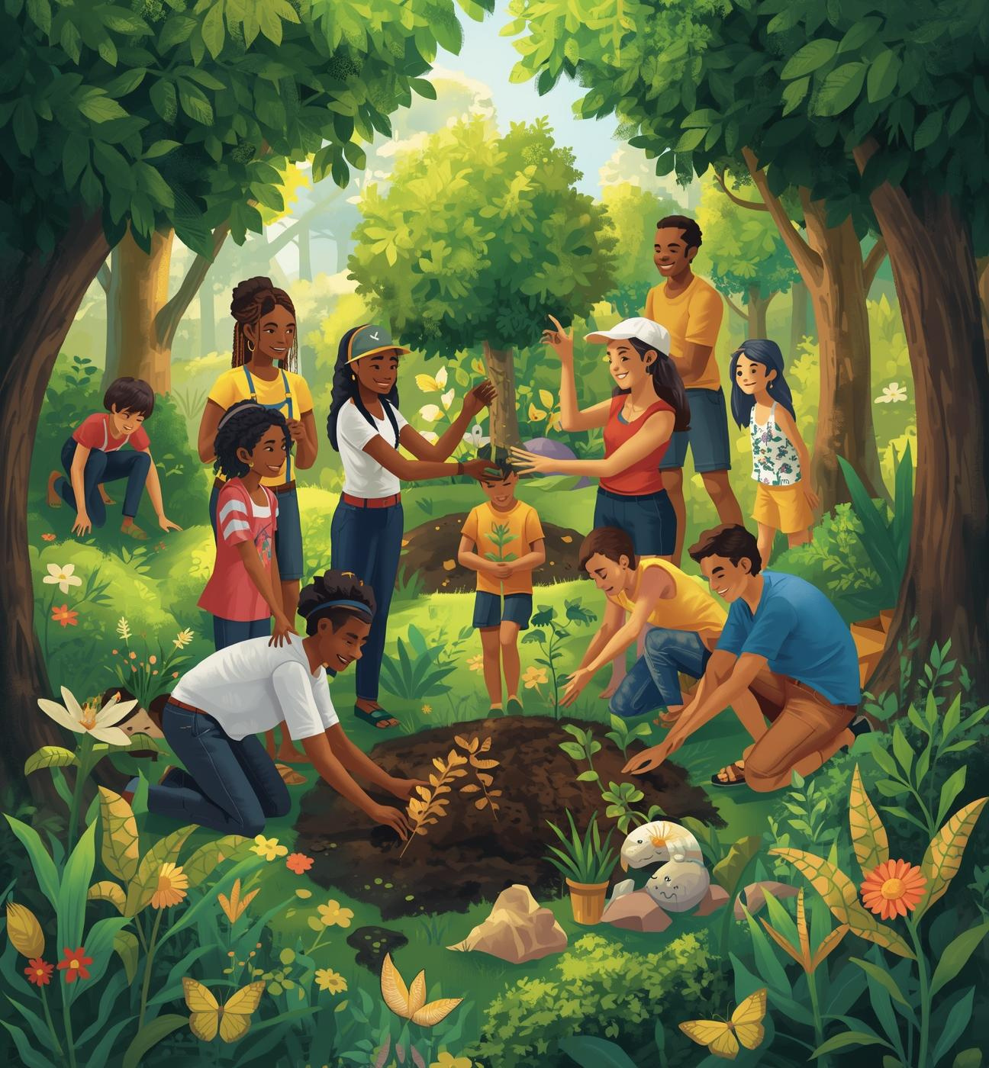
Action
Together, we can make a sustainable impact by:
  Planting trees in local communities
  Supporting conservation initiatives
  Advocating for sustainable practices
  Educating others on biodiversity importance

